Slide 1

35th ADA Anniversary Series
Ground Transportation for People with Mobility Disabilities: 35 Years after the ADA
Presenters: Anne Sommers McIntosh, Director of Legislative Affairs Kimie Eacobacci, Legislative Affairs Specialist

Slide 2
Past Briefing Recaps
Transportation disadvantages:
Less likely to own a vehicle
Less likely to have access to a vehicle
Less likely to drive a vehicle
Generational cycles of poverty
Lower employment levels
Less social capital and network deficits
Transportation Network Companies (TNCs):
4% of regions in which TNCs operate have WAVs
Non-equivalent service
Less operating hours, longer wait times
Additional fees
Driver attitudes
35th ADA Anniversary Series

Slide 3
Federal Requirements for Wheelchair-Accessible Taxis
Preamble of the ADA Transportation Regulation:
Under the ADA, private entities primarily engaged in the business of transporting people and providing demand responsive service are not required to buy accessible automobiles. Such entities are required to purchase accessible vans, unless the entity can demonstrate that it provides equivalent service. But nothing in the statute requires an entity to acquire a van; if a taxi company acquires only automobiles, it need never obtain an accessible vehicle.
35th ADA Anniversary Series

Slide 4
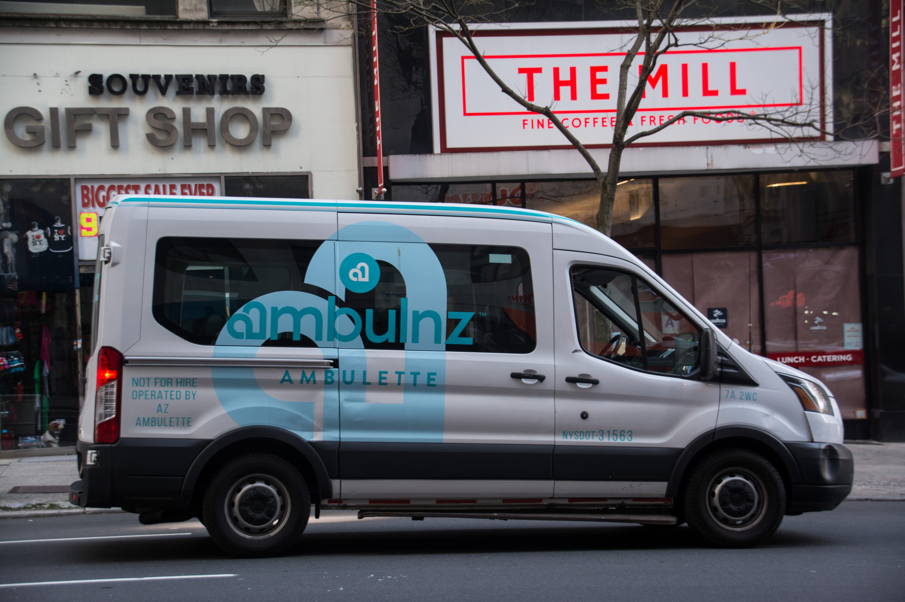
When No WAV Taxis Are Available
Specialty wheelchair transportation providers, or “ambulettes”
Commonly exorbitant fees
Disruption to plans, discourages travel
35th ADA Anniversary Series

Slide 5
TNCs’ Growth, WAV Taxis’ Decline
Taxi ridership declined 50% between 2012 (the year of the inception of TNCs / ridehailing apps) and 2017 alone
In Washington, DC, by 2023:
90% of for-hire trips were made through Uber and Lyft
Active taxi drivers had dropped from 5,000 to 1,500.
35th ADA Anniversary Series

Slide 6
TNCs’ Growth, WAV Taxis’ Decline
Imbalance in regulation
Taxis are highly regulated
Driver medical histories
Letters of recommendation
Background checks
Proof of good driving record
Vehicle painting expense
Car retirement rules
Carry sufficient cash
Carry insurance
Specific rules re: where and how for pickups
35th ADA Anniversary Series

Slide 7
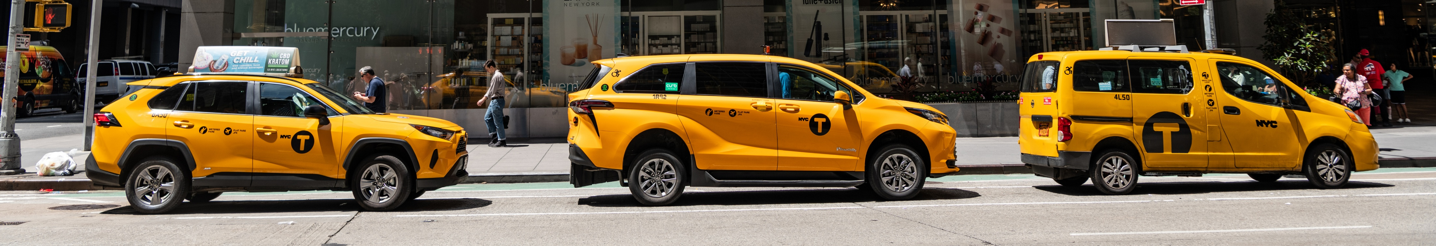
Increasing WAV Taxi Numbers
Mandates and incentives
Incentives should be focused on defraying the extra costs of owning, operating, and maintaining a wheelchair-accessible taxi
Ease of applying for incentives
Enforcement of conditions of incentives to ensure active WAV service
35th ADA Anniversary Series

Slide 8
Montgomery County, MD
County law requires that the overall number of accessible taxi licenses can be no less than 5% of the total overall in the county and that each fleet / association must provide an adequate number to meet service needs 24/7.
When the state allowed TNCs to operate within its borders without any WAVs, the County created a Transportation Services Improvement Fund and a per-trip surcharge on TNCs to offset the higher costs of owning, operating, and maintaining a WAV
35th ADA Anniversary Series

Slide 9
Montgomery County, MD
Reimbursement ordinance offers categories of distributions:
Accessible taxicab ownership
Accessible taxicab operating / driving expenses
Taxicab service incentive
Reimburses taxi owners up to $45,000 for purchase of an accessible taxicab or for conversion of a vehicle less than three model years old.
Must demonstrate WAV has been in operation for a minimum of 40 hours per week for at least 48 weeks each year for five years immediately following payment
35th ADA Anniversary Series

Slide 10
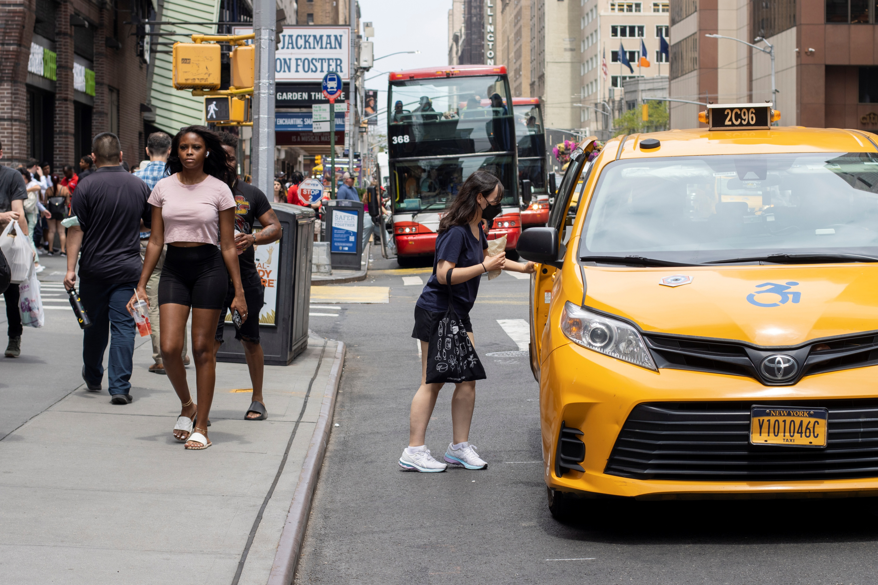
Montgomery County, MD
To further incentivize participation and offset expenses, WAV owners who successfully transport passengers requiring wheelchair service at a rate of $25 per completed trip are eligible for $0.40 per mile for every mile that the WAV travels while in service, whether or not a passenger is in the WAV and regardless of passenger type.
Enforcement mechanisms include reporting data to the DOT and consequences for fraud including returning funds, legal action, and being barred from the program
35th ADA Anniversary Series

Slide 11
Montgomery County, MD
TNC growth impacts county’s taxi fleet numbers:
In 2013, the county had five cab companies and approximately 850 cabs. In January 2025, it had fewer than 200.
In 2013, when there were 850 cabs, there were only about 26 taxi WAVs, and by January 2025, 40% of the county’s remaining taxi fleet was WAVs.
35th ADA Anniversary Series

Slide 12
Other City Snapshots
Chicago, Illinois
20 or more taxis must have 5% WAVs; 10 or more taxis must have at least 10% WAVs, and when a taxi is replaced, it must be a WAV until 10% is met; five or more taxis must have at least 25% in service as WAVs. If it replaces any taxi, it has to be a WAV until 25%.
Centralized WAV Taxicab Dispatch Service allows public to request and connect with an available WAV taxicab.
Every licensed taxi WAV is required to participate in the service.
Each taxi that is not a WAV is required to pay $22 per month to the city’s Accessibility Fund.
Fivefold increase in available WAVs from 2011 to 2021
35th ADA Anniversary Series

Slide 13
Other City Snapshots
Washington, DC
20% of fleet requirement for WAVs
Not enforced
Ordinance required fleet percentage but not active operation
Fund that could but was not required to help offset WAV costs
Never got off the ground
June 2023 – 210 of 5,322 for-hire vehicles in DC were WAVs
Only 81 of 210 WAVs were making trips (39%)
35th ADA Anniversary Series

Slide 14
Other City Snapshots
New York, NY
2015 settlement required 50% of fleet requirement by 2020.
Due to COVID, the deadline was extended to June 30, 2023.
At the deadline, Taxi and Limousine Commission reported they were at 32% and asked for the 50% requirement to be removed.
May 2024 hearing – judge ordered all new taxis accommodate wheelchairs until the 50% requirement was met.
February 2025 – 45% of active medallions were accessible
35th ADA Anniversary Series

Slide 15
Philadelphia, PA
2015 – sale of wheelchair-accessible taxi medallions began
Requirements:
Certified taxi driver
WAV instruction, pass a test (every two years)
Give preference to wheelchair users
Dispatchers must maintain 10% WAVs in their associations to be able to provide WAVs within 20 minutes 24/7 or forward to other dispatchers
No funding for assistance converting, purchasing, or maintaining WAVs
35th ADA Anniversary Series

Slide 16
Philadelphia, PA
Pre-pandemic:
1,600 taxis; 40 WAV taxis; 1,900 WAV rides annually
Today:
564 taxis; 3 WAV taxis
No city fund to assist drivers to convert, purchase, or maintain WAVs
Stipend for drivers who complete WAV training & waiver of certificate fee
35th ADA Anniversary Series

Slide 17
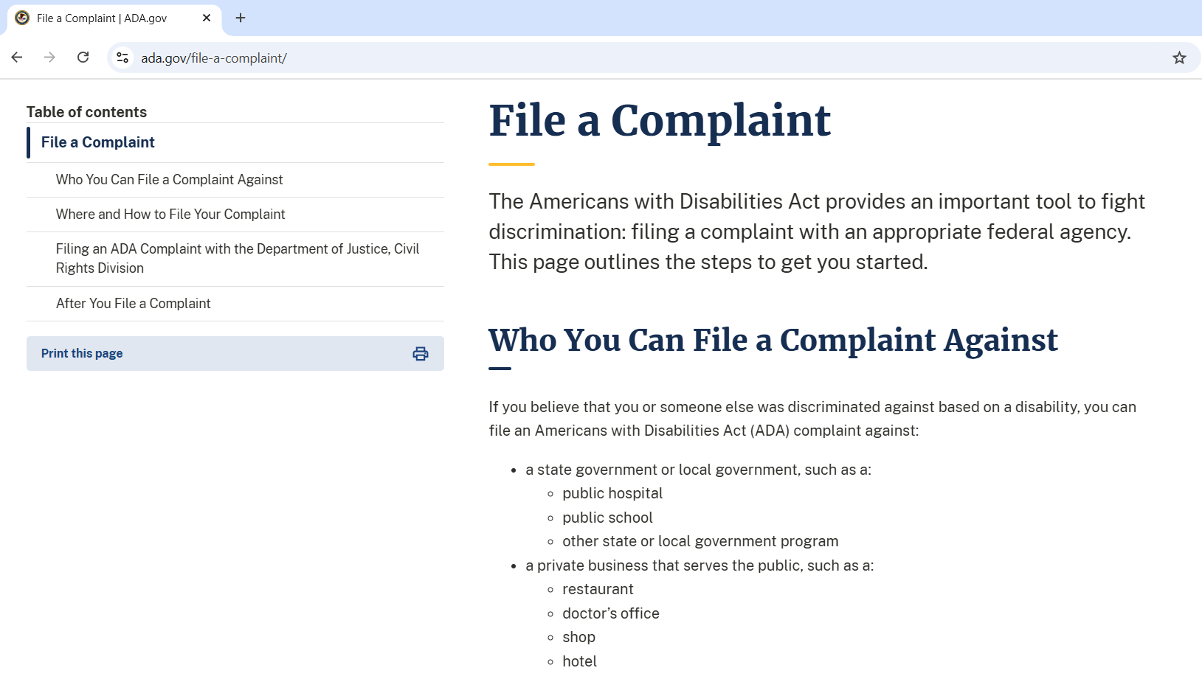
Enforcement of ADA’s Equivalent Service Requirement
35th ADA Anniversary Series

Slide 18
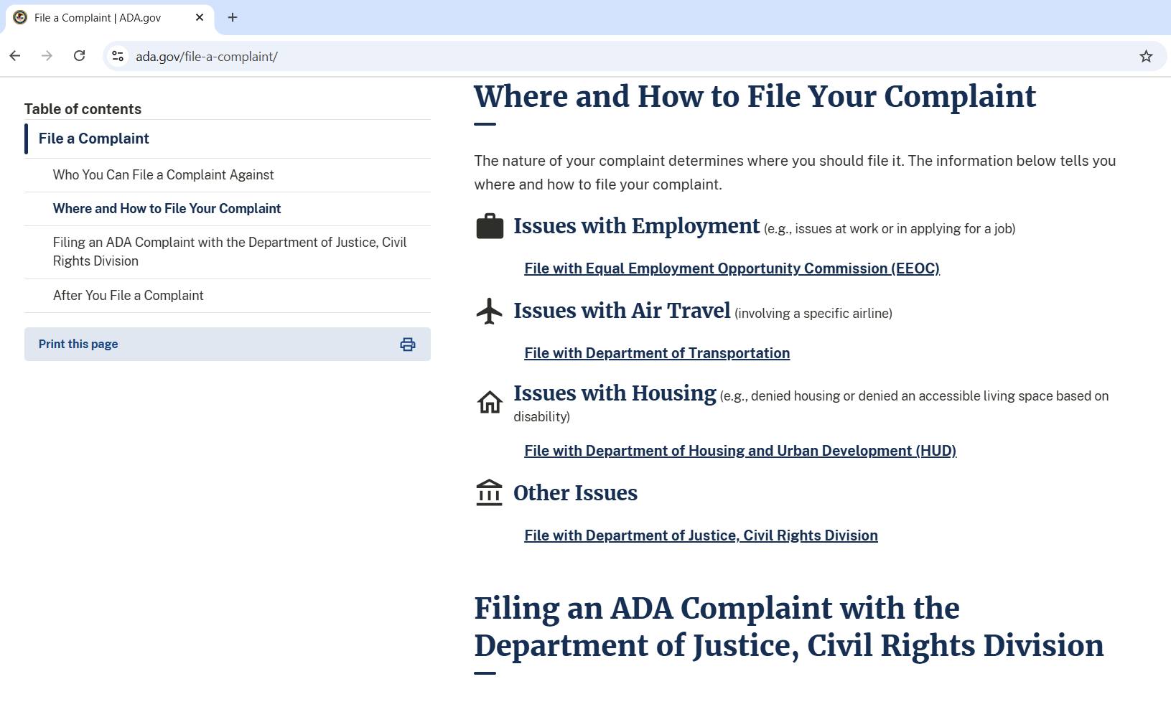
Enforcement of ADA’s Equivalent Service Requirement
35th ADA Anniversary Series

Slide 19
WAV Taxi Recommendations
U.S. Department of Justice, Civil Rights Division
The DOJ online complaint form and its corresponding database that receives complaints should be updated and modernized.
Vigorously enforce the ADA’s “equivalent service” requirement for taxis.
35th ADA Anniversary Series

Slide 20
WAV Taxi Recommendations
Require or incentivize WAVs by law
Cities and counties – TNCs must provide WAVs as prerequisite to doing business or pay fee to fund taxi drivers to purchase, convert, and maintain WAVs
States – Impose a surcharge on TNCs to incentivize taxi drivers to be WAV drivers
Congress – TNCs, taxi companies, and AV companies that deploy robotaxis should be required to provide and maintain an active percentage of WAVs in each community in which they operate
35th ADA Anniversary Series

Slide 21
WAV Taxi Recommendations
U.S. Department of Transportation, Office for Civil Rights Amend its ADA regulation or issue a new regulation to require taxi
services, TNCs, and autonomous taxi services to have a percentage of WAVs in service and available in each locality where they operate.
35th ADA Anniversary Series

Slide 22
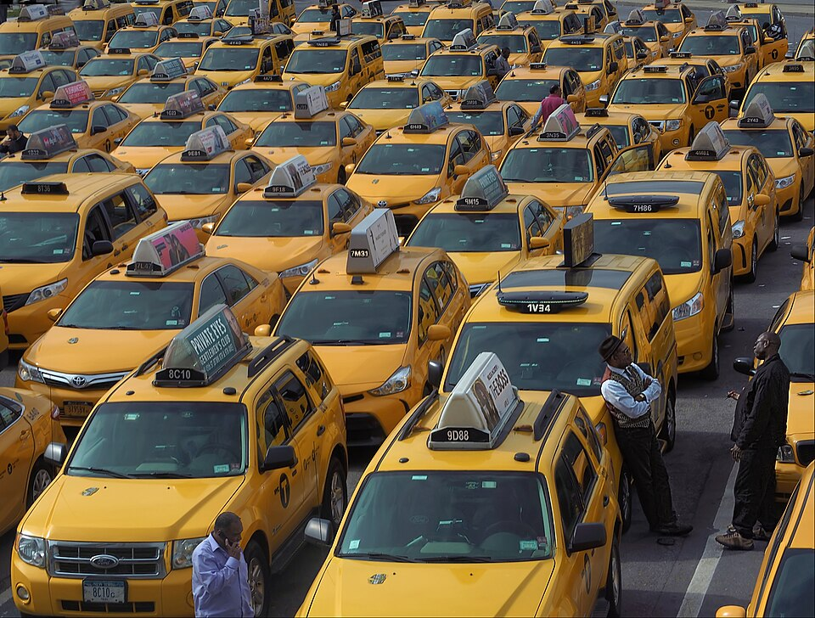
WAV Taxi Recommendations
Federal Highway Administration (FHWA)
FHWA should delve into greater detail in the questions asked in the National Household Travel Survey to better understand whether users of taxis and ridehail services are WAV users or not.
35th ADA Anniversary Series

Slide 23
Next Briefing
Autonomous Vehicle Accessibility
Wednesday, August 13, 2025
2:00 PM EDT
35th ADA Anniversary Series

